Slide 1

SWD 392 - Software Architecture and Design

Slide 2
Case Study
CHAPTER 23: Component-Based Software Architecture Case Study

Slide 3
Table of contents
01
Problem Description
04
Dynamic Modeling
02
Use Case Modeling
05
Design Modeling
03
Static Modeling
06
Software Component Deployment

Slide 4

01 Problem description
The Emergency Monitoring System
An Emergency Monitoring System consists of several remote monitoring systems and monitoring sensors that provide sensor input to the system.
The status of the external environment is monitored with a variety of sensors. Some of these sensors are attached to remote monitoring systems, which send regular status input that is stored at a monitoring service.
In addition, from the sensor information, alarms are generated concerning undesirable situations in the external environment that require human intervention.
Monitoring operators view the status of the different sensors and view and update alarm conditions.

Slide 5
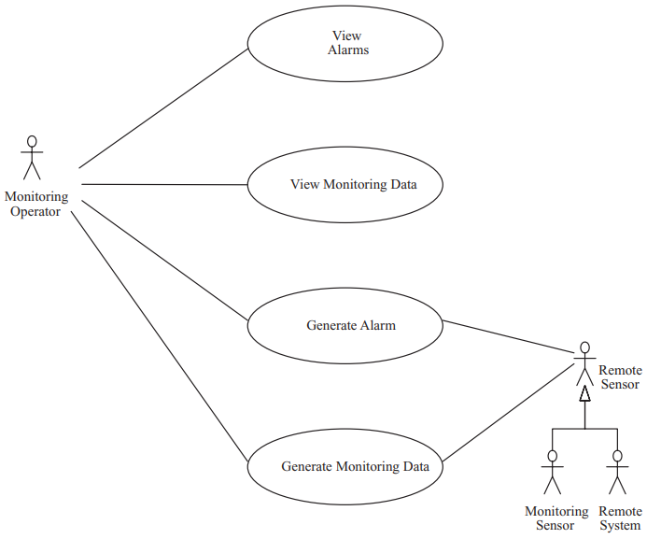
02 Use Case Modeling
Actors: Monitoring Operator, Monitoring Sensor & Remote System
Monitoring Sensor & Remote System behave in a similar way. This similar behavior can be modeled by a generalized actor, Remote Sensor.
Use cases overview:
View Alarms: views outstanding alarms and acknowledges the cause.
View Monitoring Data: view the current status of one or more sensors.
Generate Monitoring Data: monitoring data are generated
Generate Alarm: an alarm is generated if an alarm condition is detected
Emergency Monitoring System use cases and actors

Slide 6
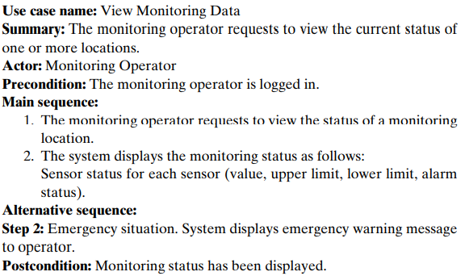
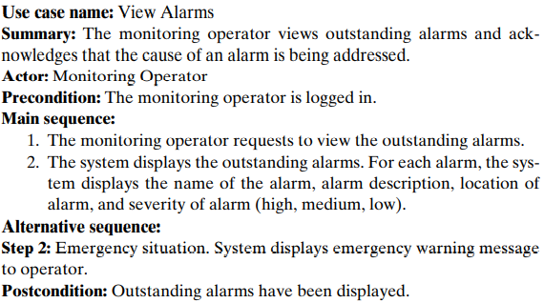
02 Use Case Modeling
View Monitoring Data use case description
View Monitoring Data use case description

Slide 7
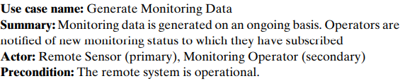
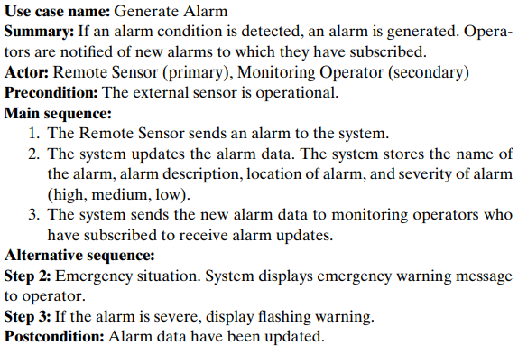
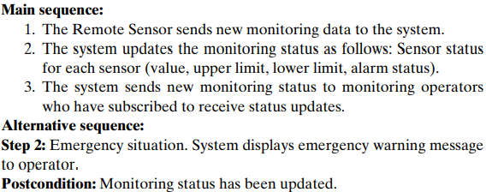
02 Use Case Modeling
Generate Monitoring Data use case description
Generate Alarm use case description

Slide 8
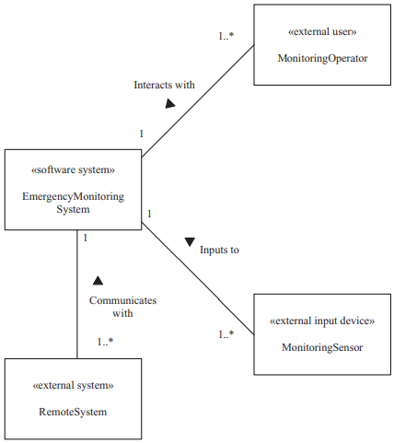
03 Static Modeling
For the Emergency Monitoring System, the external classes consist of one external user Monitoring Operator, one external system Remote System, and one external input device, Monitoring Sensor.
Since there are multiple instances of each external class, each of the external classes has a one-to-many association with the Emergency Monitoring System.
The common behavior of Remote System and Monitoring Sensor is captured by means of a generalized external class, Remote Sensor.
Browse Catalog

Slide 9
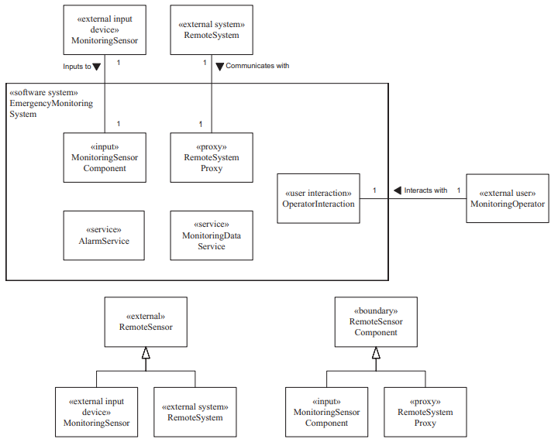
04 Dynamic Modeling
The entity classes for the Emergency Monitoring System are Alarm Data Repository and Monitoring Data Repository.
There is one human actor, Monitoring Operator, and a corresponding user interaction class, Operator Interaction.
In addition, there is an input object, Monitoring Sensor Component.
There is a proxy object, Remote System Proxy, which receives sensor data and also sends status data.
Finally, there is a boundary superclass, Remote Sensor Component.
Class structuring for Emergency Monitoring System

Slide 10
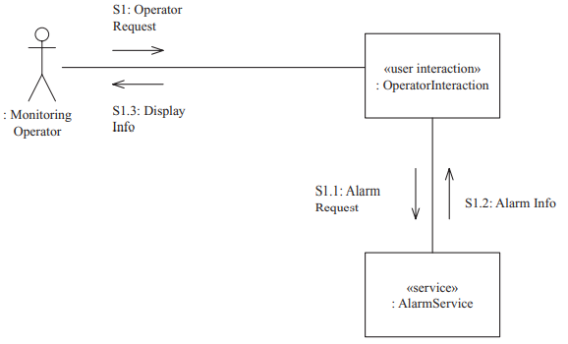
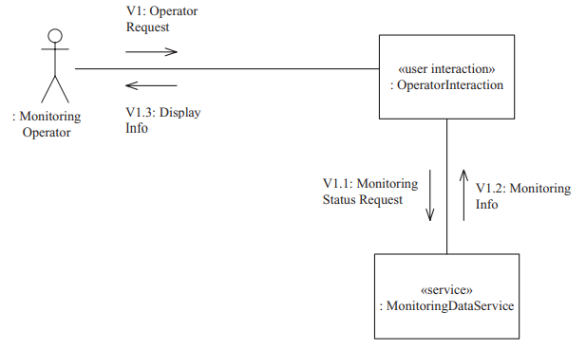
04 Dynamic Modeling
Communication diagram for the View Alarms use case
Communication diagram for the View Monitoring Data use case

Slide 11
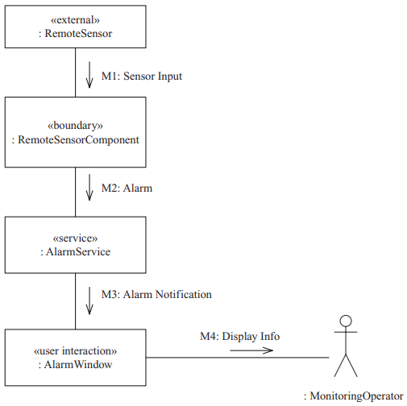
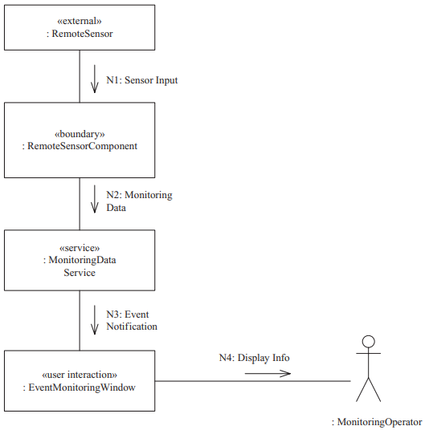
04 Dynamic Modeling
Communication diagram for the Generate Alarm use case
Communication diagram for the Generate Monitoring
Status use case

Slide 12
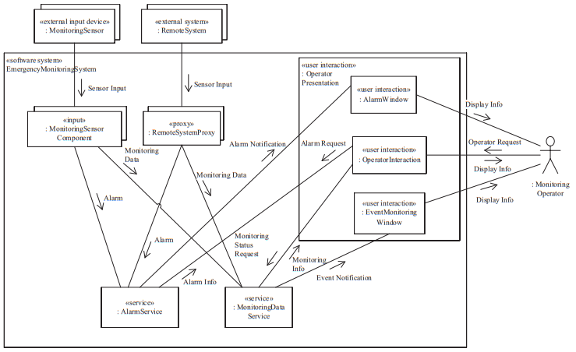
05 Design Modeling
Integrated Communication diagram for Emergency Monitoring System

Slide 13
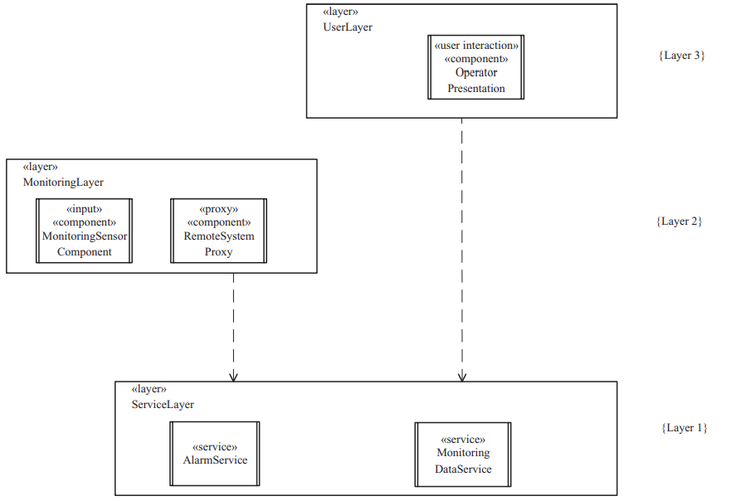
05 Design Modeling
Layer 1: Service Layer. This layer consists of the services Alarm Service and Monitoring Data Service.
Layer 2: Monitoring Layer. This layer consists of the Remote System Proxy and Monitoring Sensor Component. The components require the two services at the Service Layer.
Layer 3: User Layer. This layer consists of the user interaction component Operator Presentation and the components it contains.
If two layers do not depend on each other, such as layers 2 and 3 in the preceding
list, the choice of which layer should be higher is a design decision.
Layered architecture of the Emergency Monitoring System

Slide 14
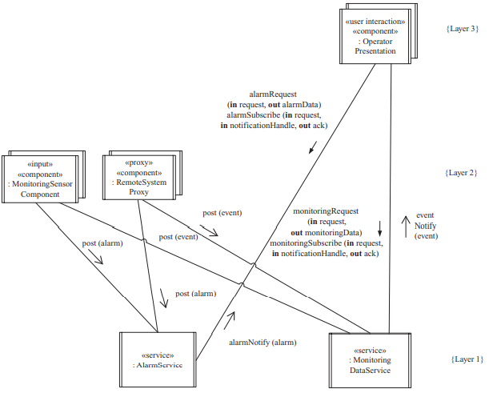
05 Dynamic Modeling
To handle the variety of communication between the components in the software architecture, several communication patterns are applied:
Synchronous Message Communication with Reply
Asynchronous Message Communication.
Broker Handle.
Service Discovery.
Subscription/Notification (Multicast).
Concurrent communication diagram for the Emergency Monitoring System

Slide 15
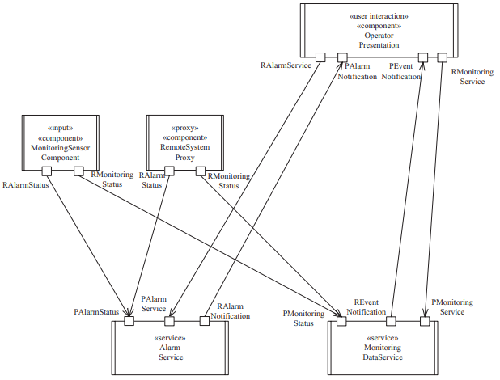
05 Dynamic Modeling
The software architecture of the Emergency Monitoring System depicts two services that each support two provided ports with provided interfaces and one required port with a required interface.
Two client components, Remote System Proxy and Monitoring Sensor Component, each support two required ports with required interfaces.
The third client component, Operator Presentation, has two required ports, each with a required interface, and two provided ports, each with a provided interface.
Distributed component-based software architecture for Emergency Monitoring System

Slide 16
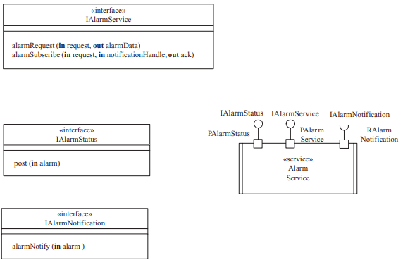
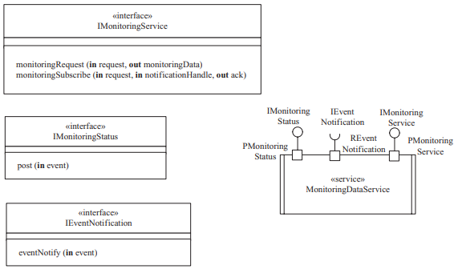
05 Dynamic Modeling
Component interfaces of Alarm Service
Component interfaces of Monitoring Data Service

Slide 17
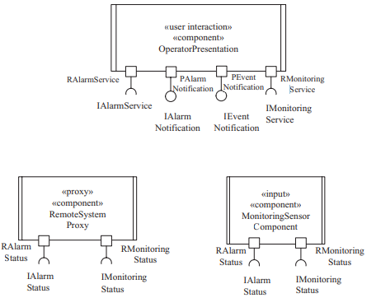
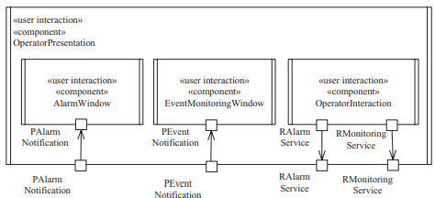
05 Dynamic Modeling
Component interfaces of user interaction components
Component interfaces of client components

Slide 18
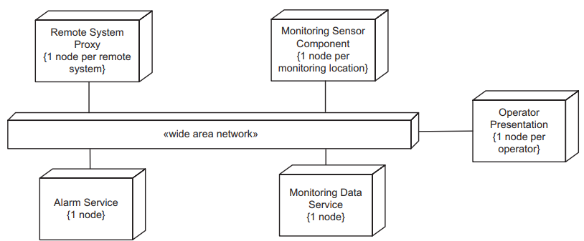
06 SOFTWARE COMPONENT DEPLOYMENT
Each client component (of which there are multiple instances) and each service is assigned its own physical node.
The client components are Monitoring Sensor Component (one node per monitoring location), Remote System Proxy (one node per remote system), and Operator Presentation (one node per operator).
Deployment diagram for an Emergency Monitoring System
The services are Monitoring Data Service and Alarm Service (one node per service). The nodes are interconnected by means of the Internet.

Slide 19
Thank you for listening!

